Slide 1
STAC51 TUT02
Mar 18, 2021

Slide 2
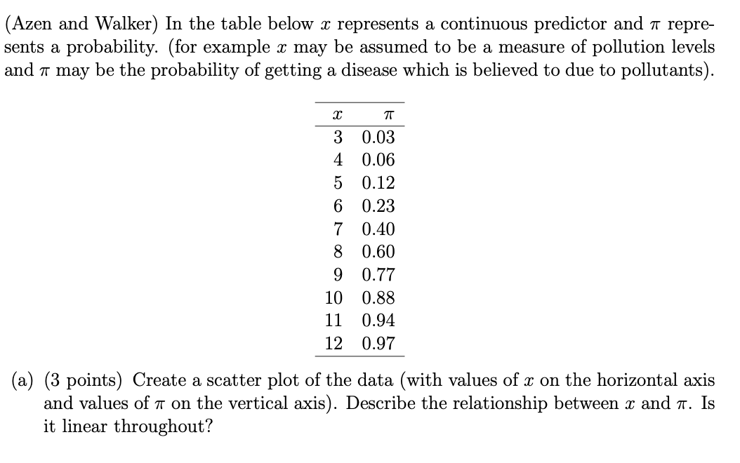
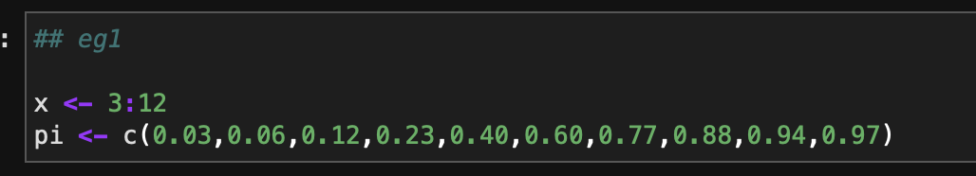
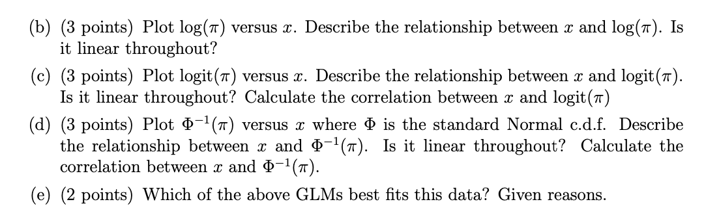

Slide 3
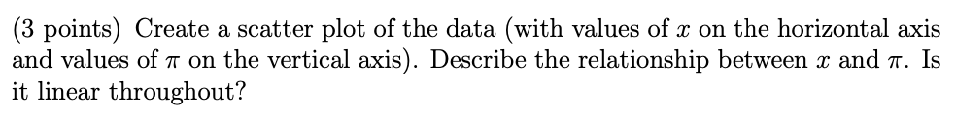
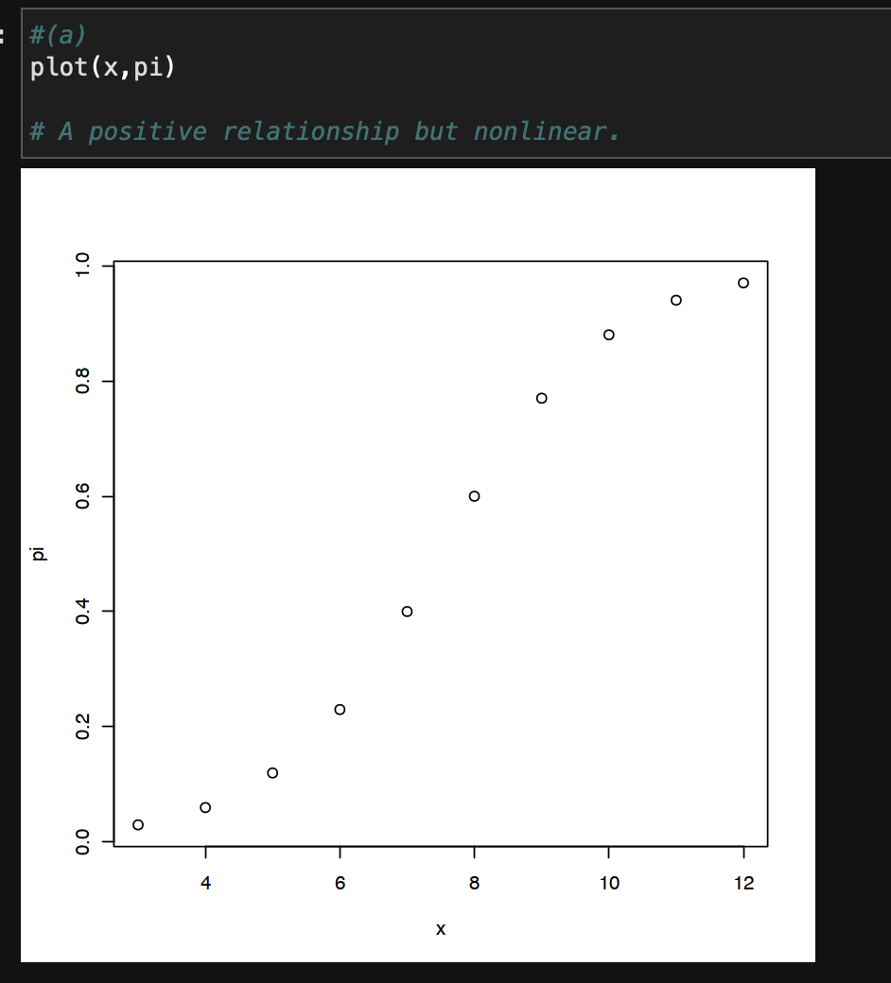

Slide 4
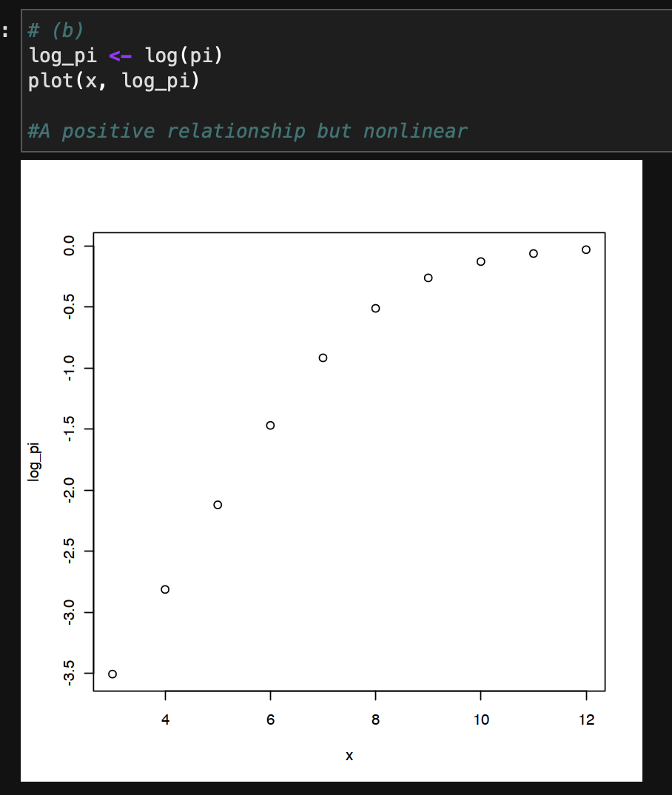

Slide 5
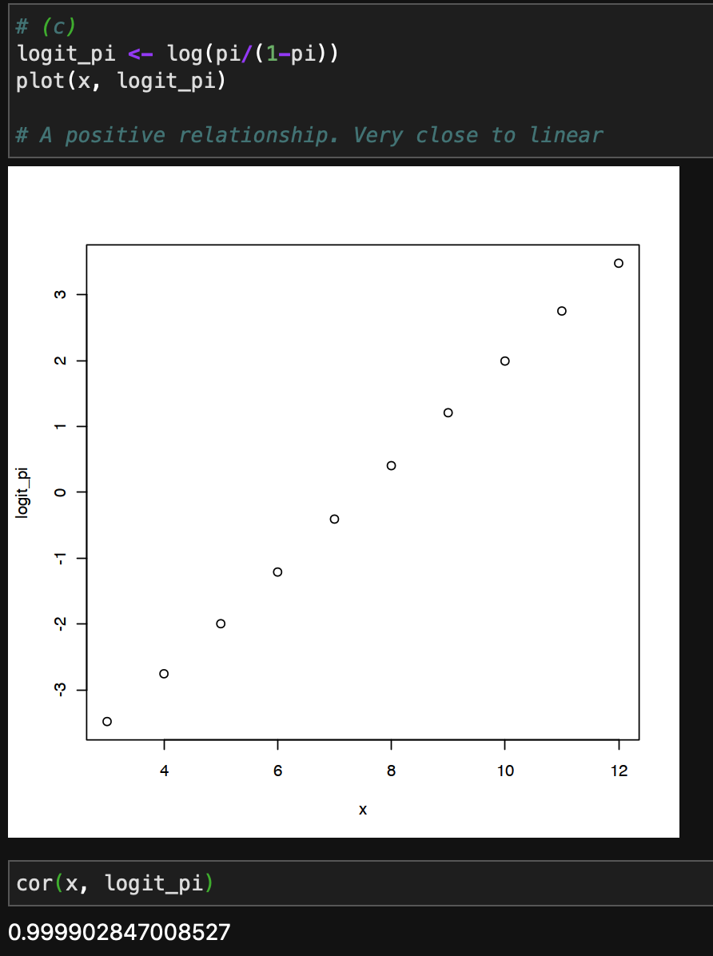

Slide 6
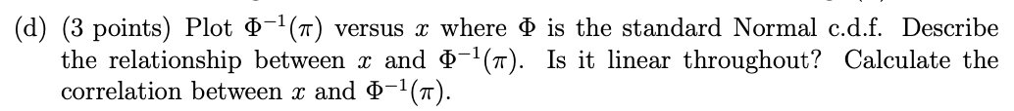
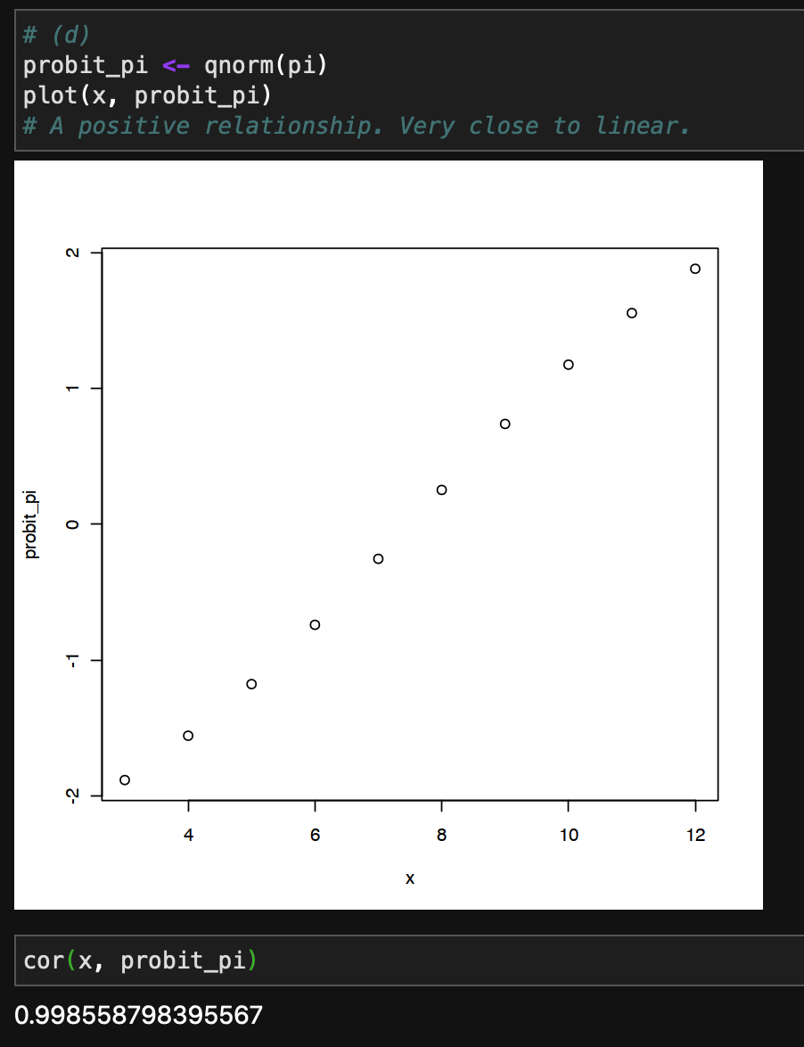

Slide 8
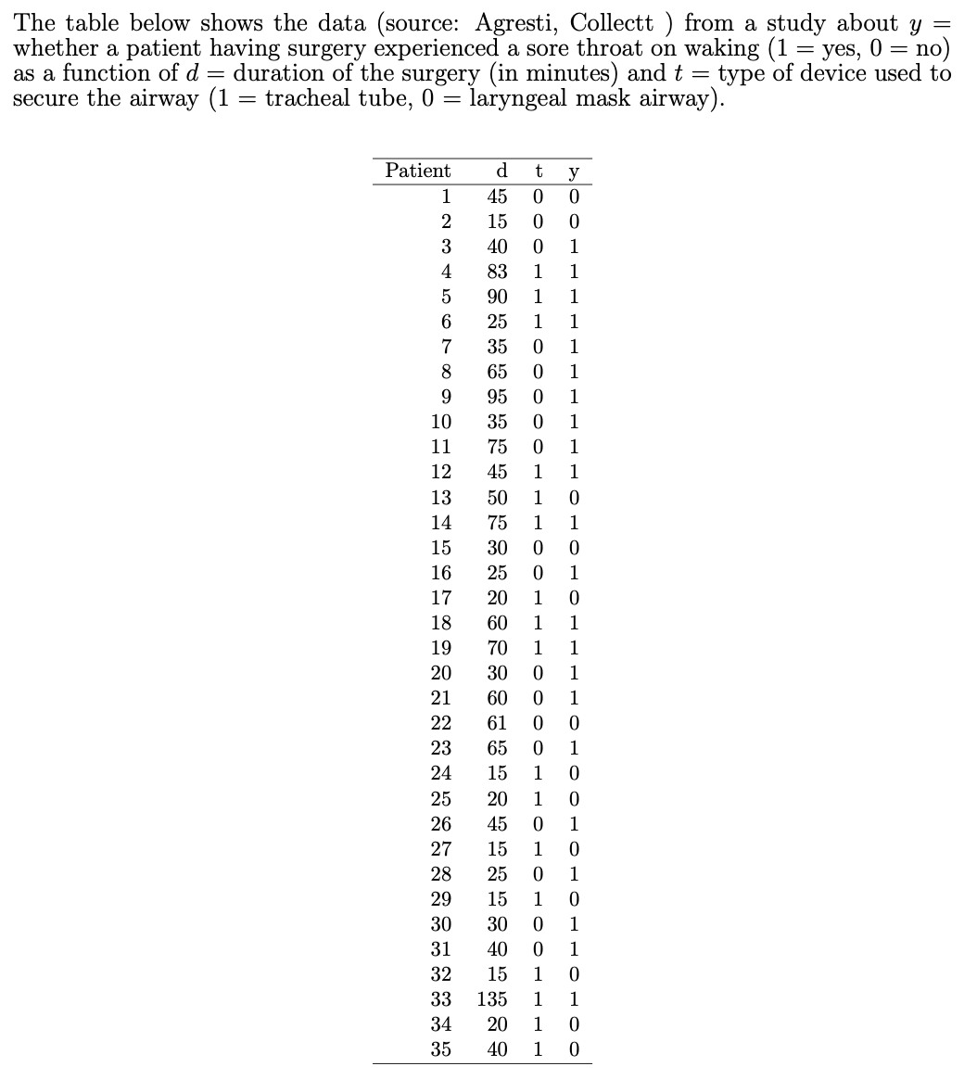
Fit a main effects model using these predictors. Interpret parameter estimates.
Conduct inference about the D effect in (1).
Fit a model permitting interaction. Report the prediction equation for the effect of D when (i) T = 1, (ii) T = 0. Interpret.
Conduct inference about whether you need the interaction term in (c).
Overlay the fitted logistic curves corresponding to the main effects model in the left-hand plot and the inter-action model in the right-hand plot, and using different line types for T= 0 versusT= 1. Include legends on your plots

Slide 9
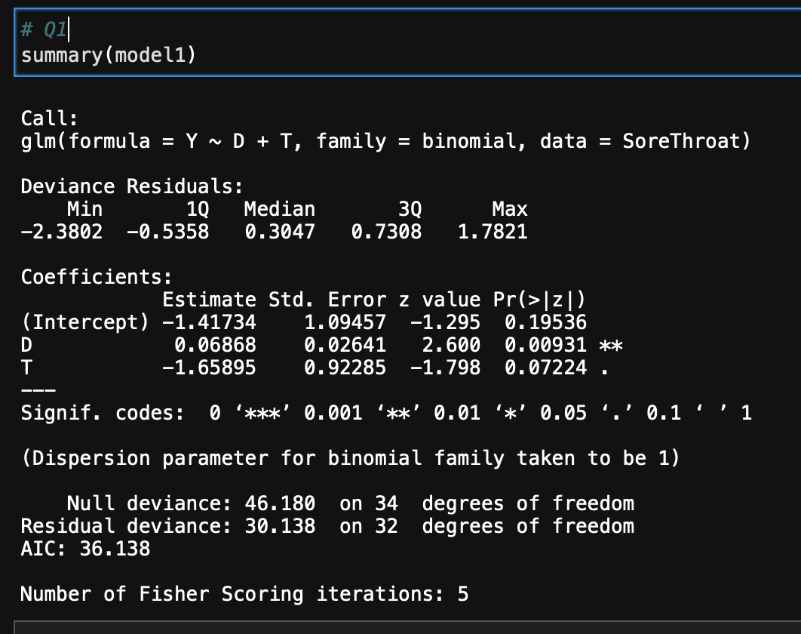
Fit a main effects model using these predictors. Interpret parameter estimates. Conduct inference about the D effect

Slide 10
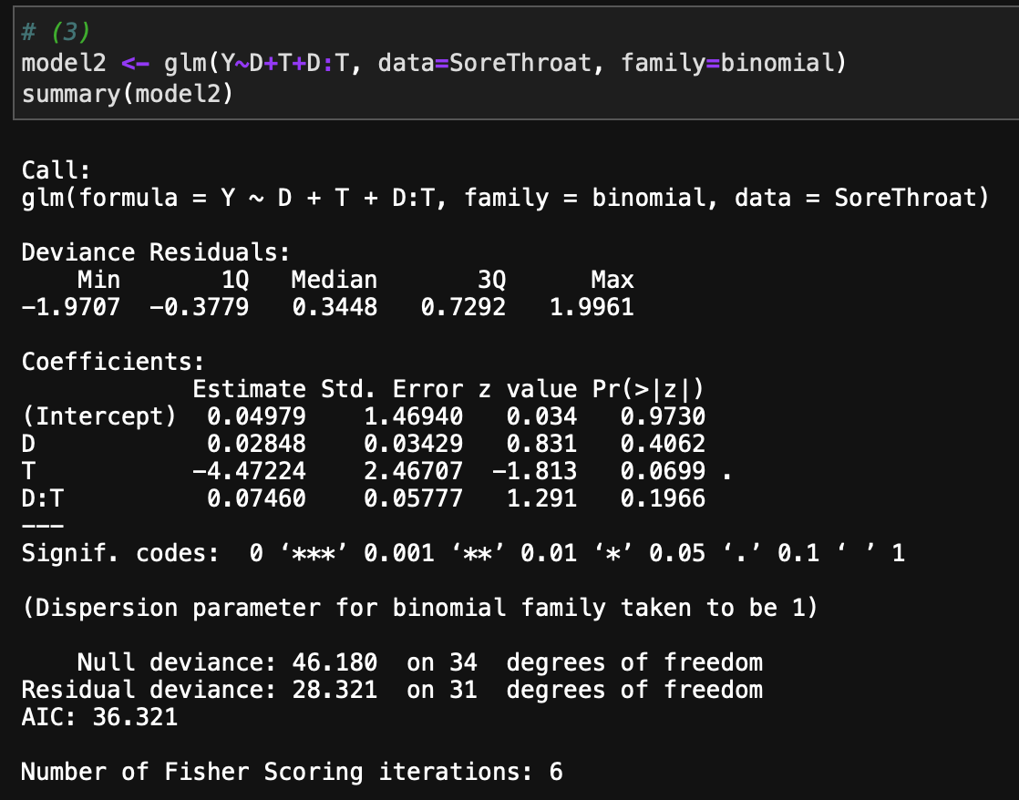
Fit a model permitting interaction. Report the prediction equation for the effect of D when (i) T = 1, (ii) T = 0. Interpret.

Slide 11
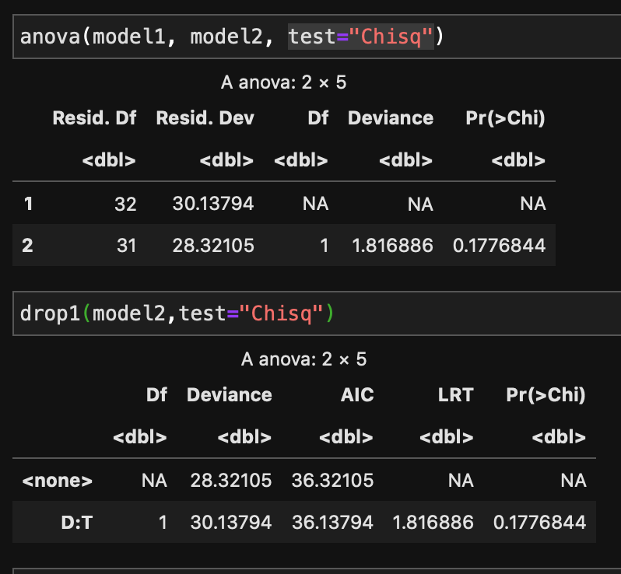
Conduct inference about whether you need the interaction term in (c).

Slide 12
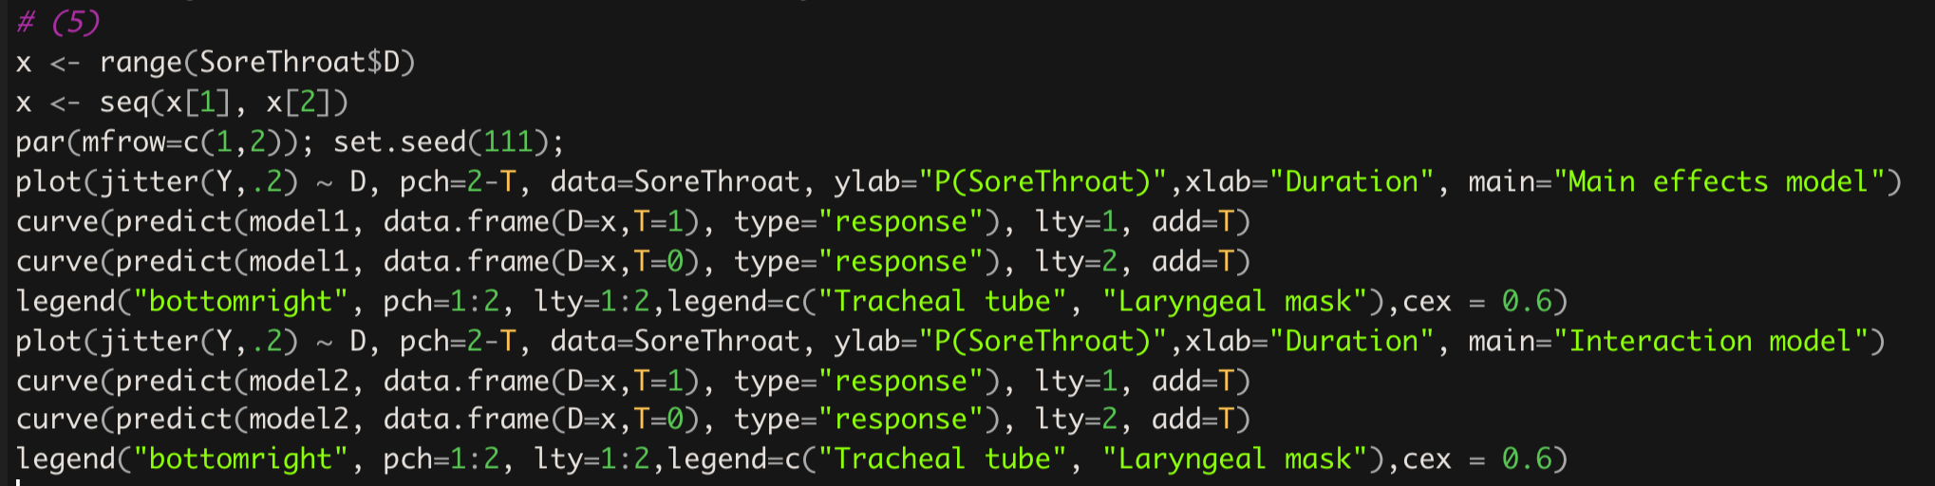
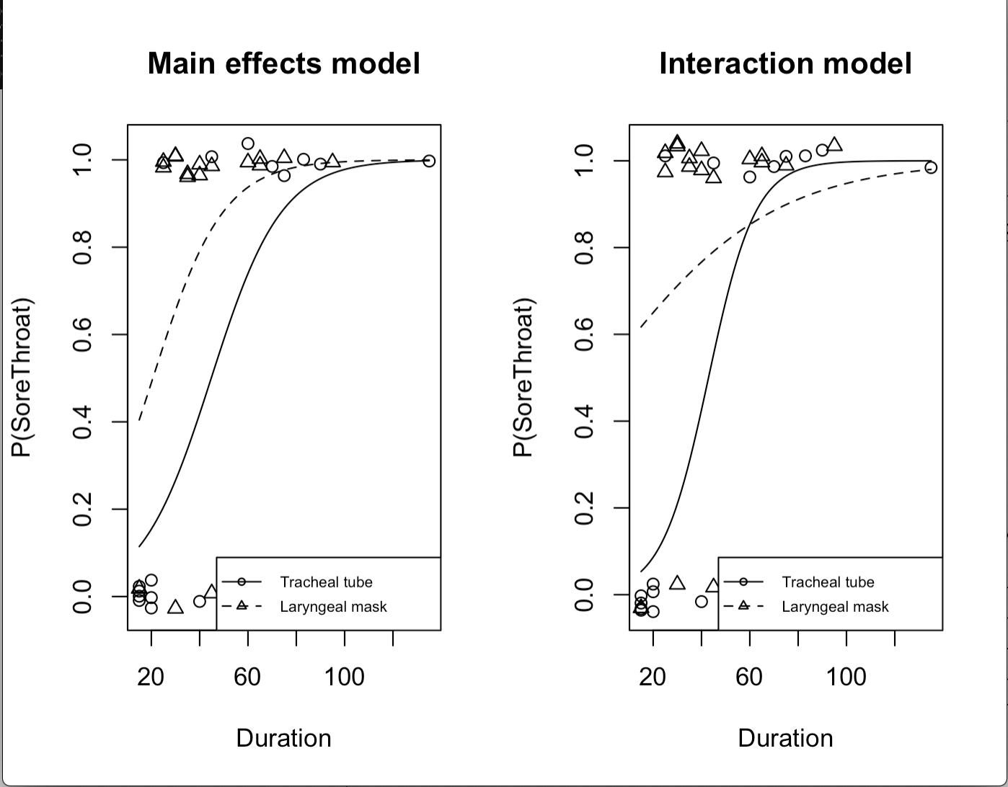

Slide 13
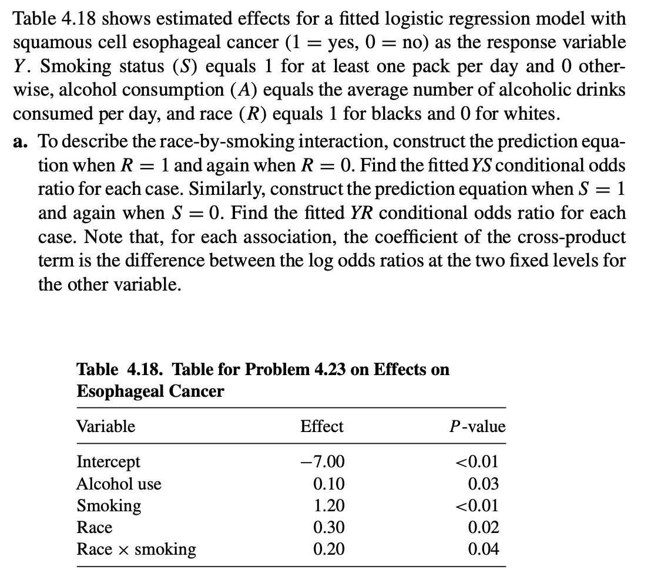
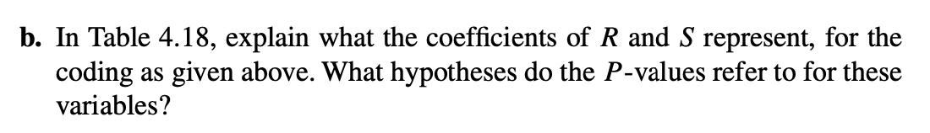

Slide 14
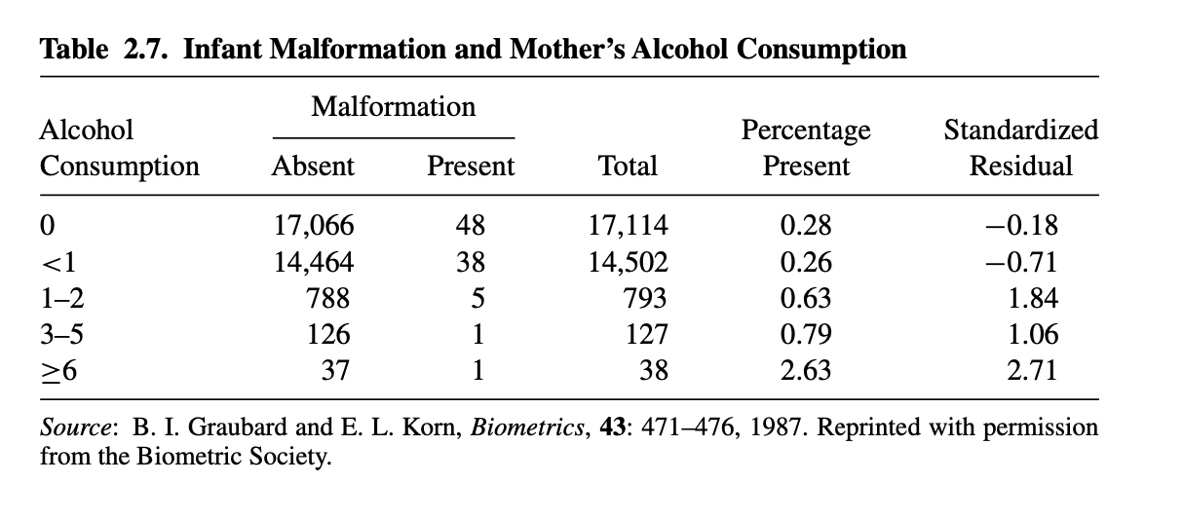
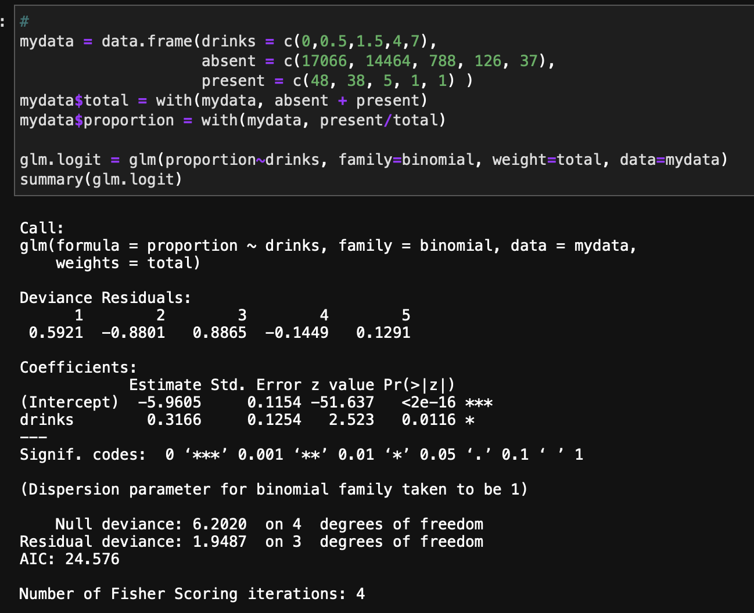
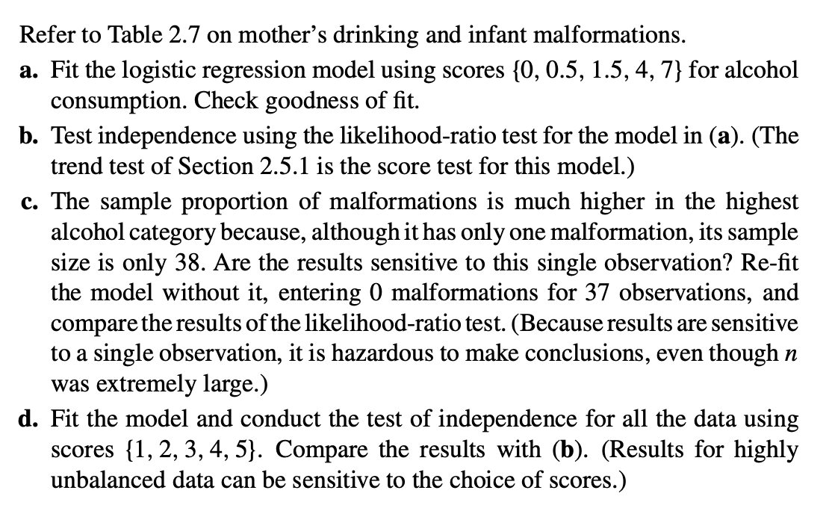
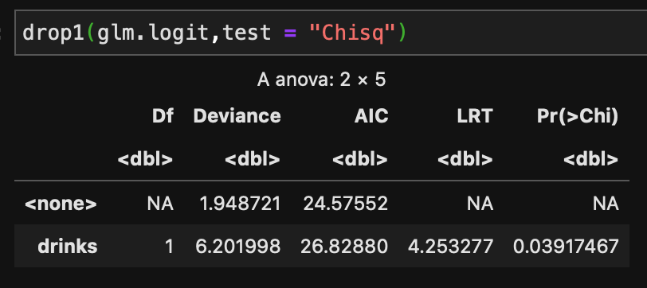

Slide 15
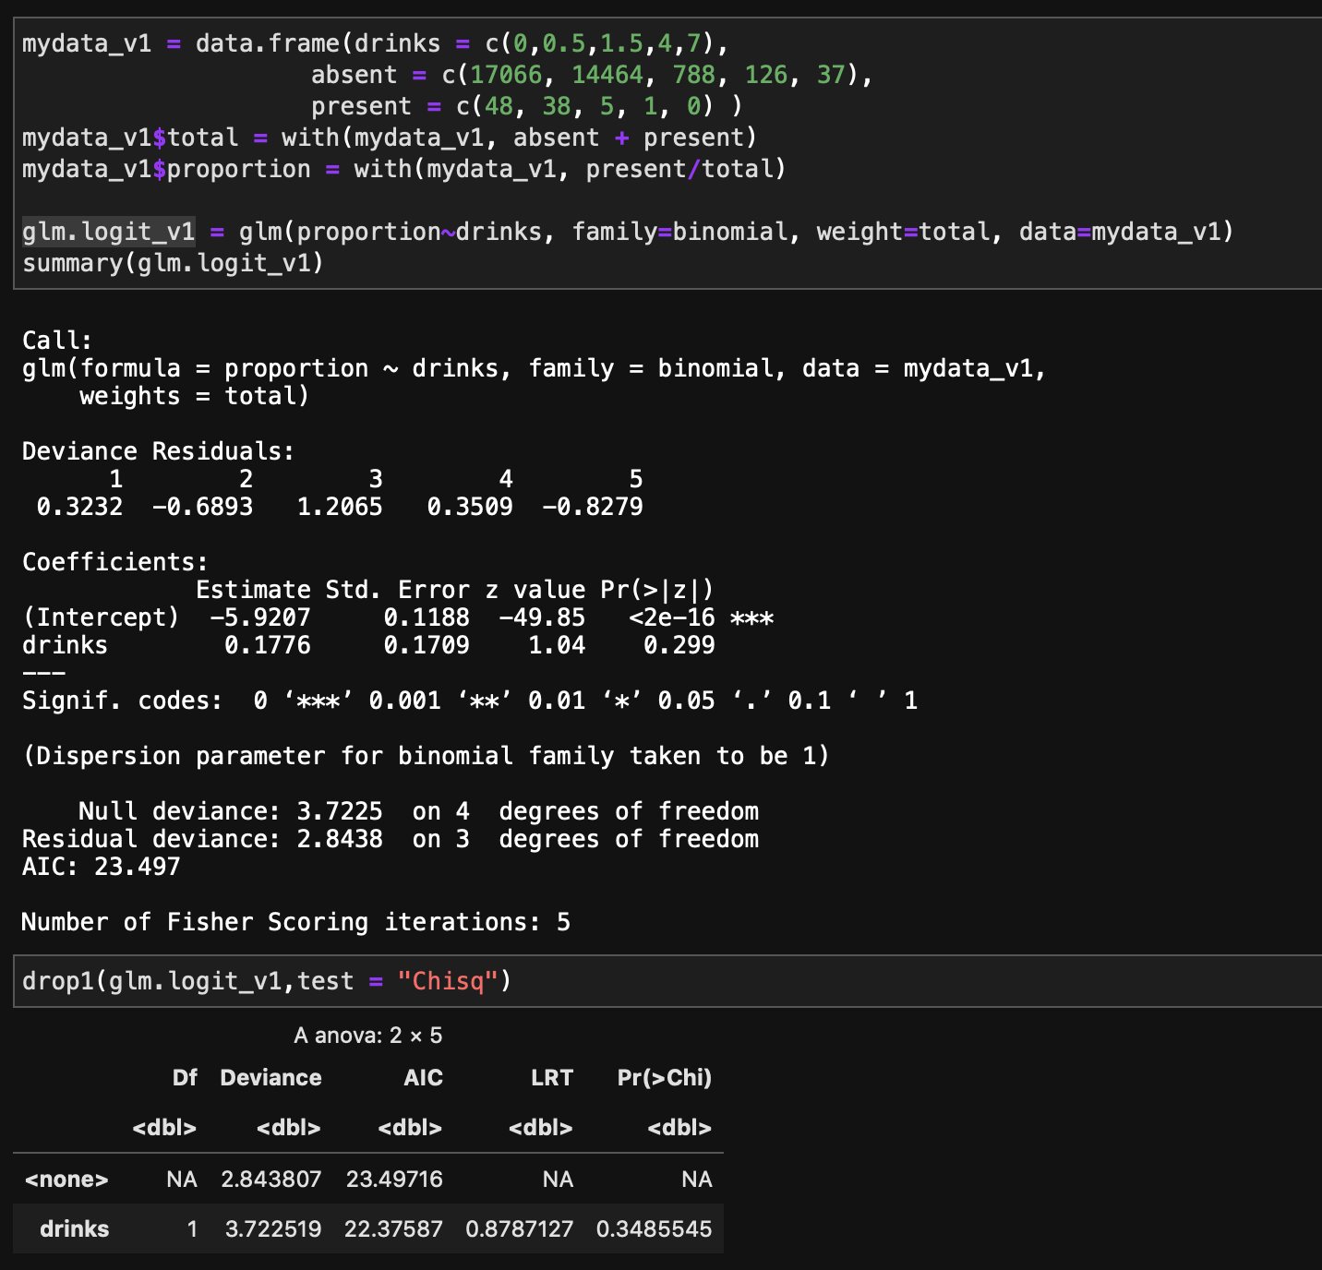

Slide 16
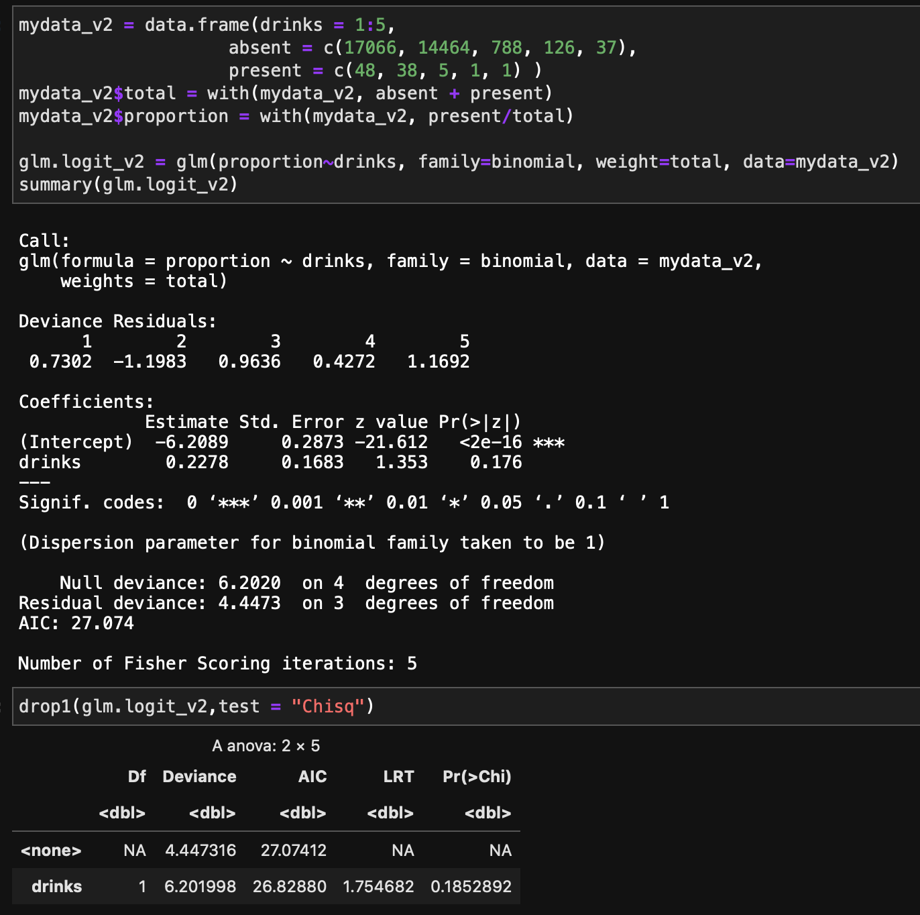

Slide 17
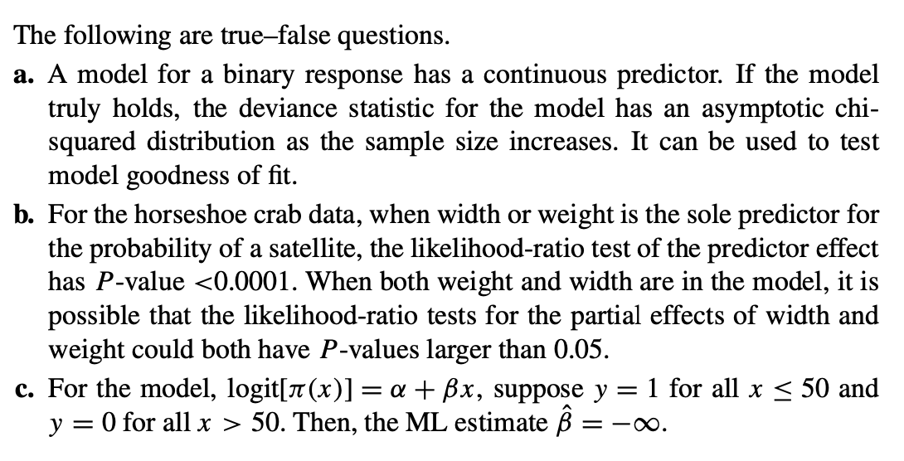

Slide 18
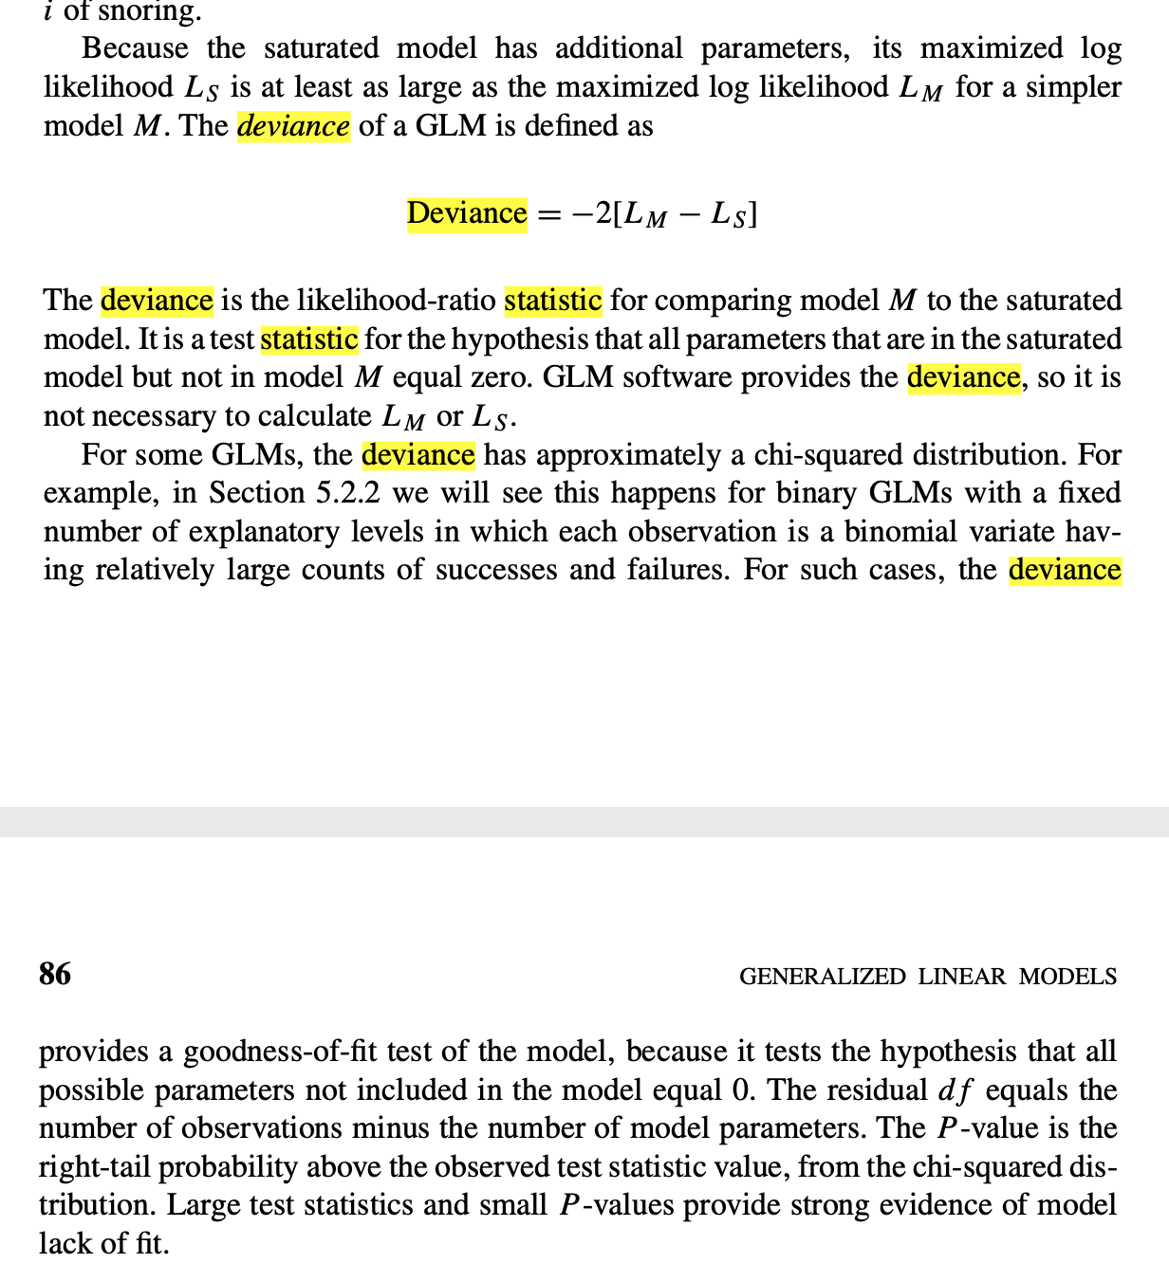
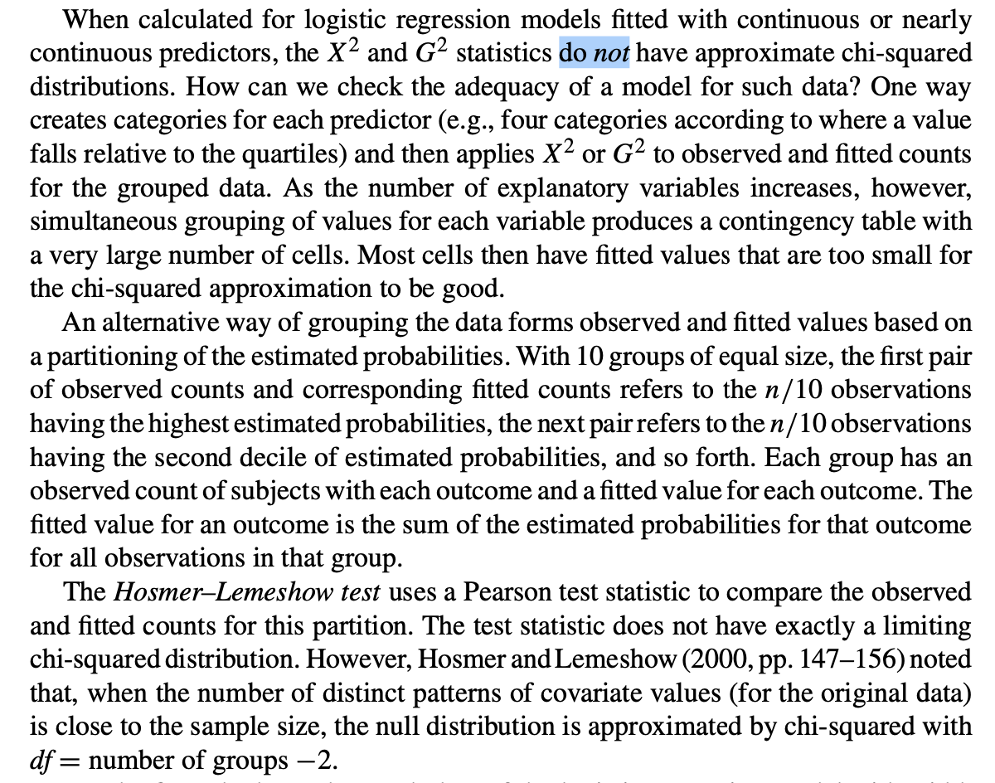
Textbook: 3.4.3, 5.2.3

Slide 19
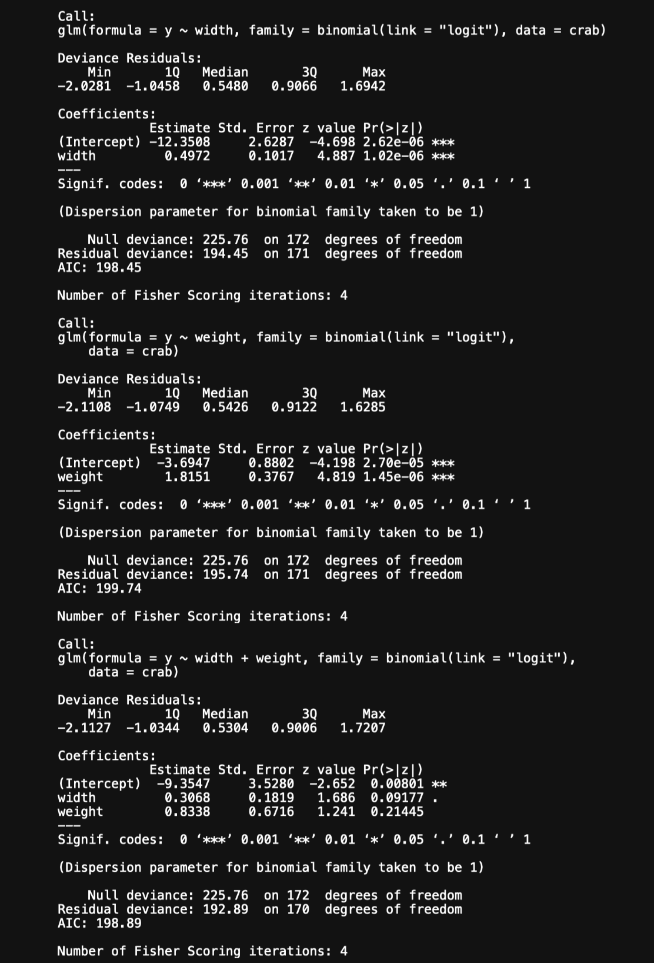

Slide 20
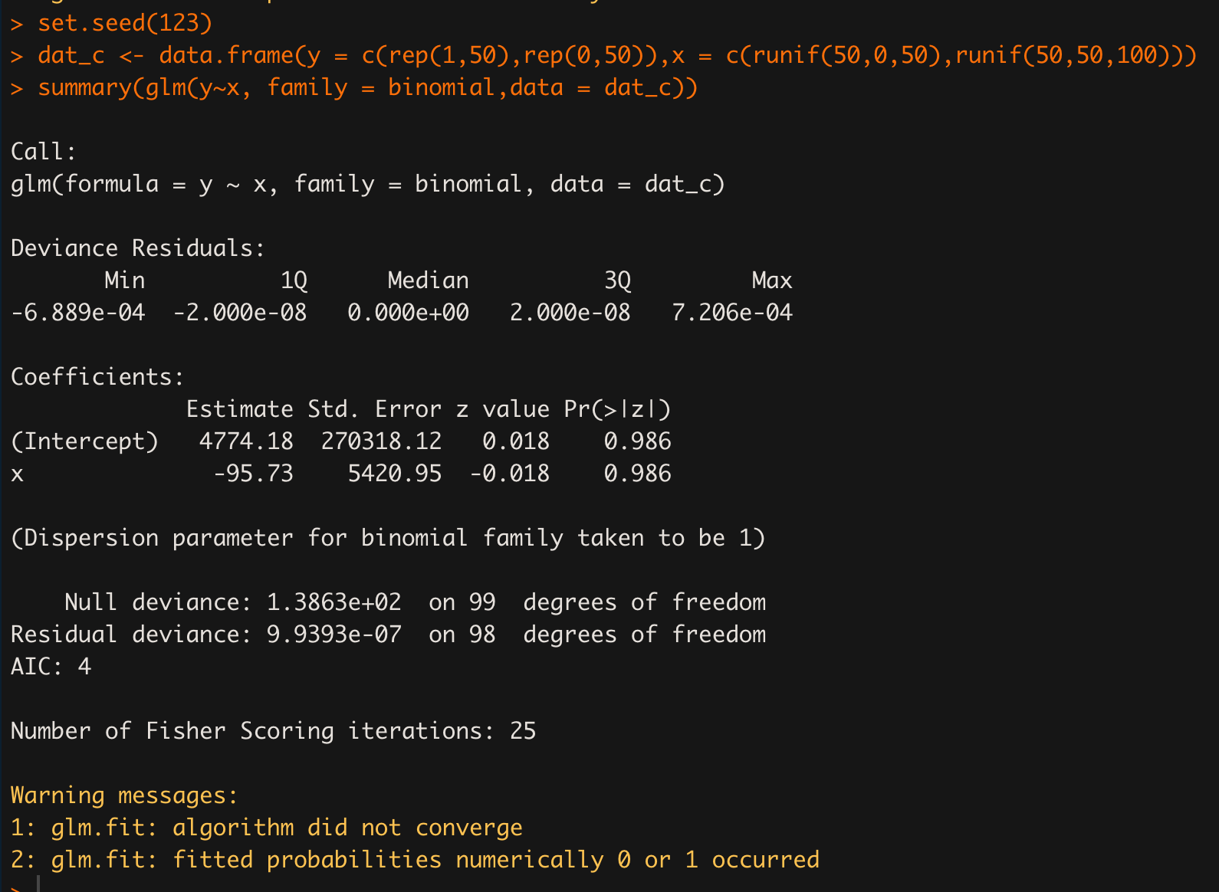

Slide 21
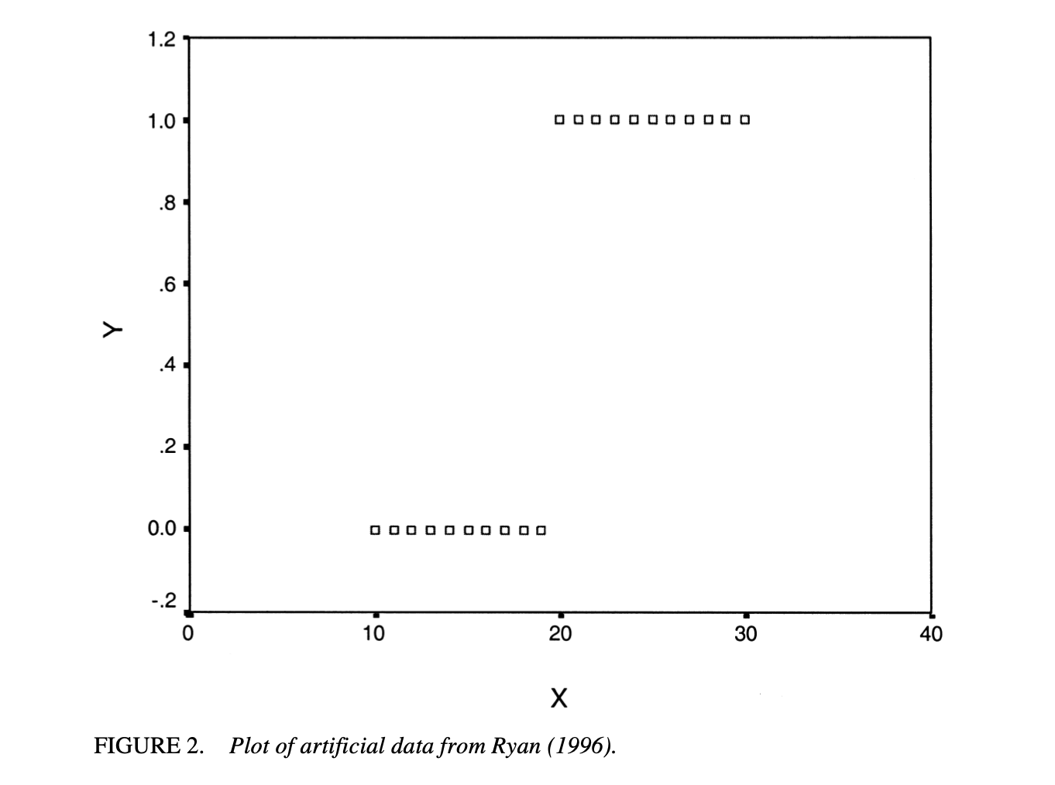
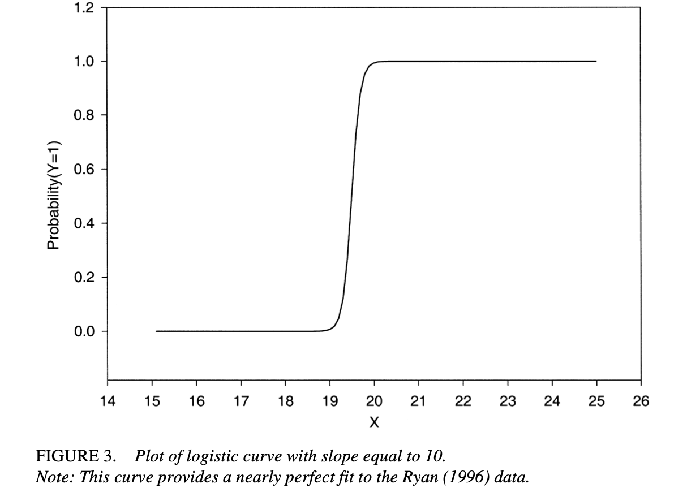
1. Rindskopf D. Infinite Parameter Estimates in Logistic Regression: Opportunities, Not Problems. Journal of Educational and Behavioral Statistics. 2002;27(2):147-161. doi:10.3102/10769986027002147

